Slide 1
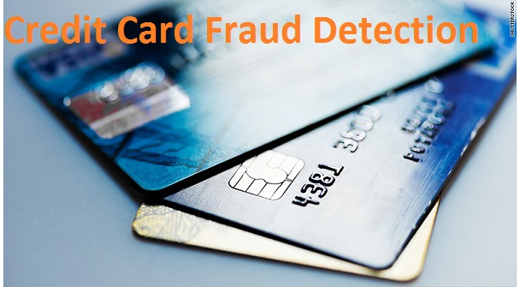
Credit Card Fraud Detection- CAPSTONE
Kuntal Chakraborty
UPGRAD-LIBA BA C6

Slide 2
Agenda
Current Situation
Objective
Percentage Of Fraud
Analysis
Last 24 hrs transaction is Crucial
ML-Importance-Use Case
Cost benefit Analysis
Recommendation
INTUTIONAL
Different Model Performance Analysis
Model Performance Over View % wise
Final Model Selection
Recall- To catch the Fraud
Other Performance of XGB 8
TECHNICAL

Slide 3

Situation
Finex is A leading Bank In Florida US
Products: Credit Card, ATM, Online-Banking and Others
Goal: To retain high value customers for smooth growth
Problem: ?
Loss Of Bank
Loosing Customers
Higher Interest Rate To Over Come The Loss
Customer
Time Waste
Money Waste
Threat Toward The Goal

Slide 4
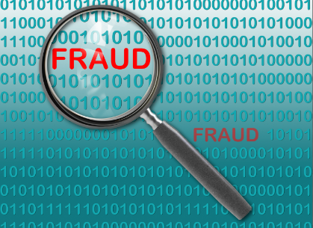
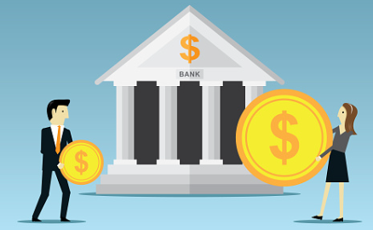

Objective: To Make The Goal Safe
Prevent Fraud Transactions
Save Money of Bank & Consumers
Enhance Customer Trust

Slide 5
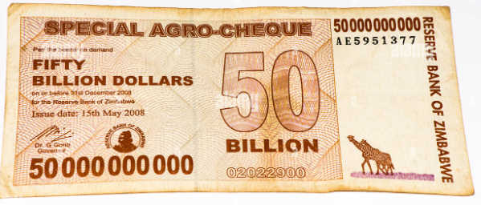
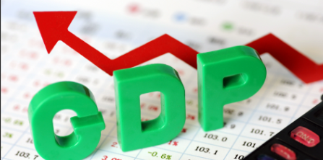
CC Fraud
Credit card fraud is an inclusive term for fraud committed using a payment card, such as a credit card or debit card
Every year 50 Billion Dollar is Being Fraud
That is 6% of Total World GDP

Slide 6
Finex Bank Fraud- What Happened?
SL | Particular | Numbers
1 | Average number of transactions per month | 77183
2 | Average number of fraudulent transaction per month | 402
3 | Average amount per fraud transaction | 531 $
Before Applying ML
2,13,462-/Month is being Stolen From the Bank

Slide 7

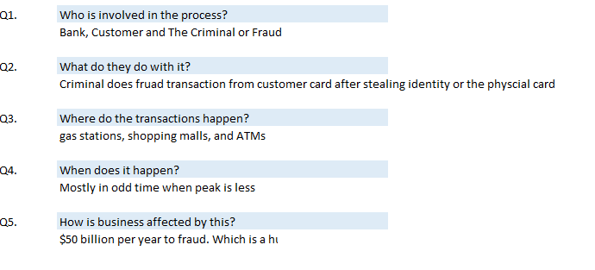
Our Understanding

Slide 8
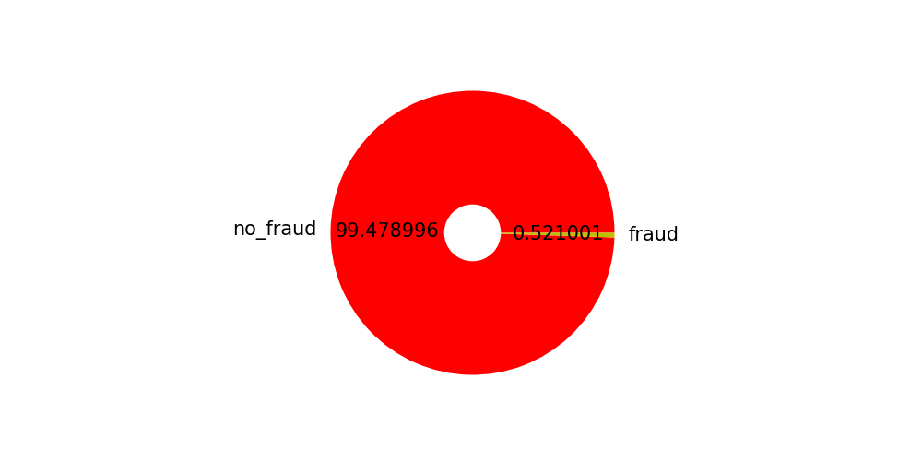
Percentage Of Fraud
In Given Data % of fraud = 0.52% vs 99.47% Geniun Transaction

Slide 9
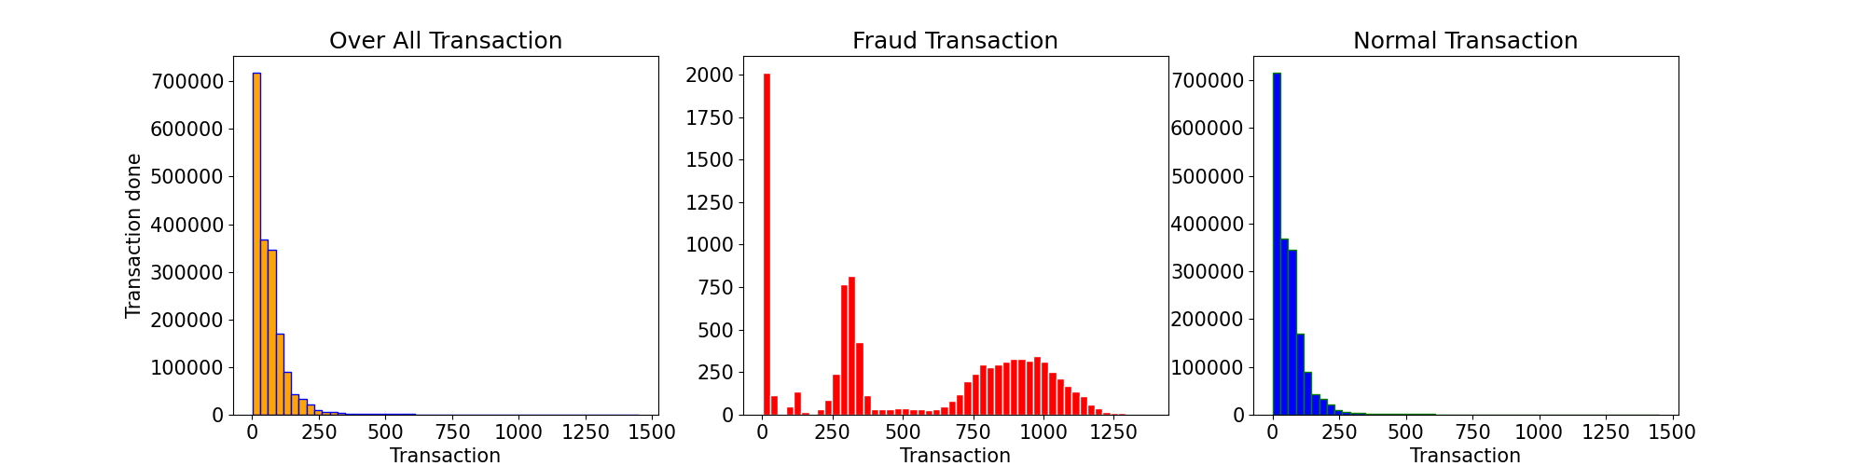
Amount Distribution
Fraud people max transaction amount don’t cross 1500, max transaction is done by fraud is in mid range.
(1$-10$) (200$-400$) and (600$-1250$) Fraud transaction are heights in these ranges in
Note: We have limit the amount less than or equal to 1450 as fraud max bill amount is lesser than the limit

Slide 10
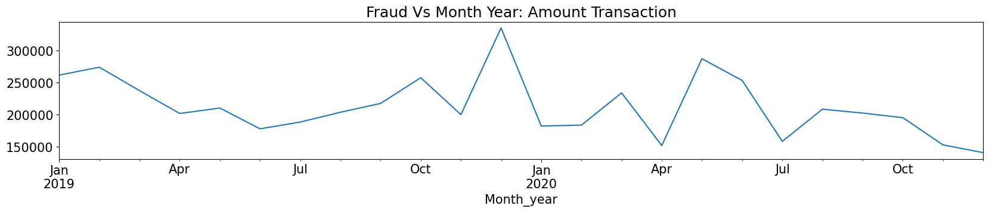
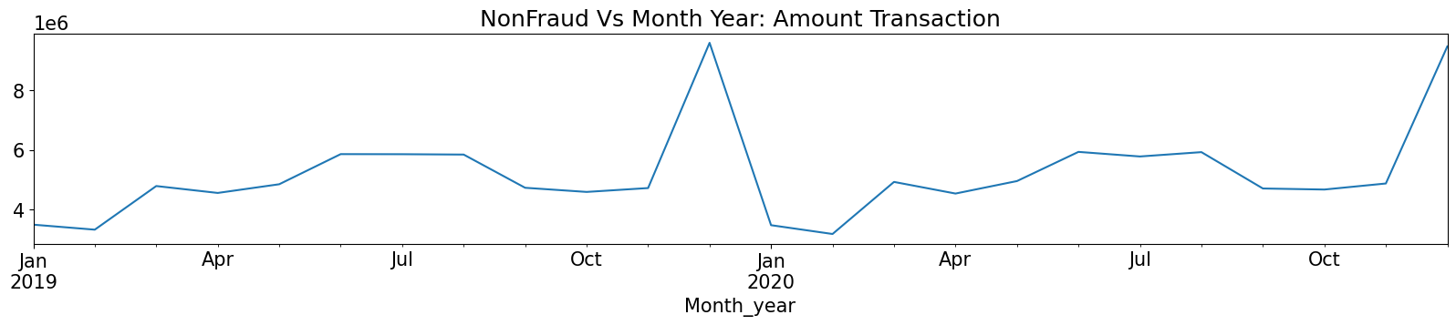
Amount Transaction Month_Year
Genuine Transaction: Peak in December month but other than that no perfect seasonality.
Fraud Transaction : 2019 a Peak in Dec but not seen in 2020. And no Seasonality

Slide 11
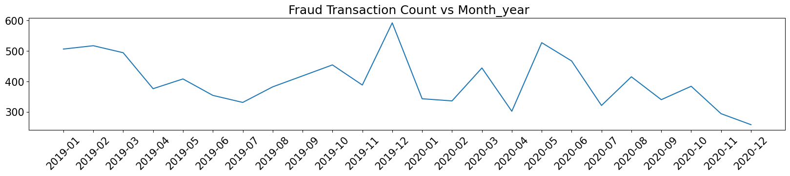
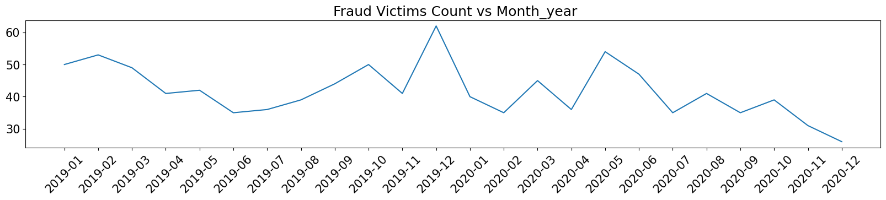

Same Card Multiple Fraud
The Fraud Transaction count: Ranging 250-600
Customer Count: Ranging 20-60
Same Card Has Been Used For Multiple Fraud Transaction

Slide 12
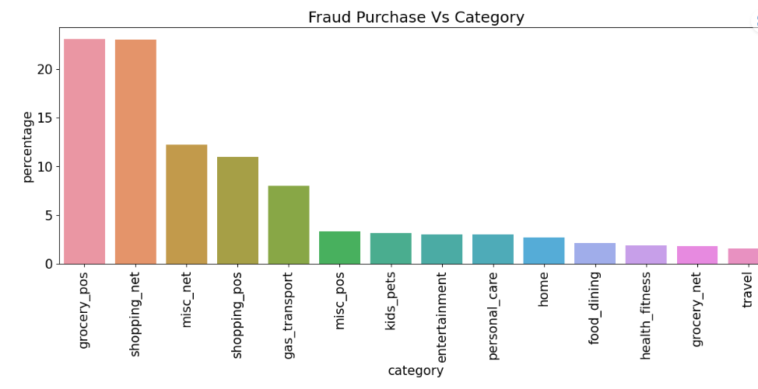
Purchasing Habits of A Fraud
Category | Category count | Percentage
grocery_pos | 2228 | 23.09
shopping_net | 2219 | 22.99
misc_net | 1182 | 12.25
shopping_pos | 1056 | 10.94
gas_transport | 772 | 8.00
misc_pos | 322 | 3.34
kids_pets | 304 | 3.15
entertainment | 292 | 3.03
personal_care | 290 | 3.00
home | 265 | 2.75
food_dining | 205 | 2.12
health_fitness | 185 | 1.92
grocery_net | 175 | 1.81
travel | 156 | 1.62
Grocery, Shopping, Misc: High Fraud Transaction
Travel, Health, Grocery net, Health Fitness : Less Transaction Among All Fraud Transaction

Slide 13
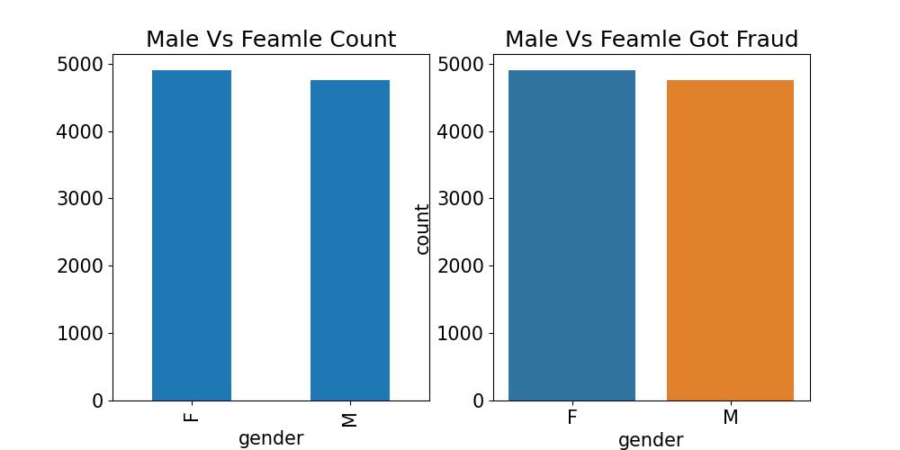


Fraud Don’t Discriminate Gender
Over all % of Male & Female
Male & Female Fraud Affect

Slide 14
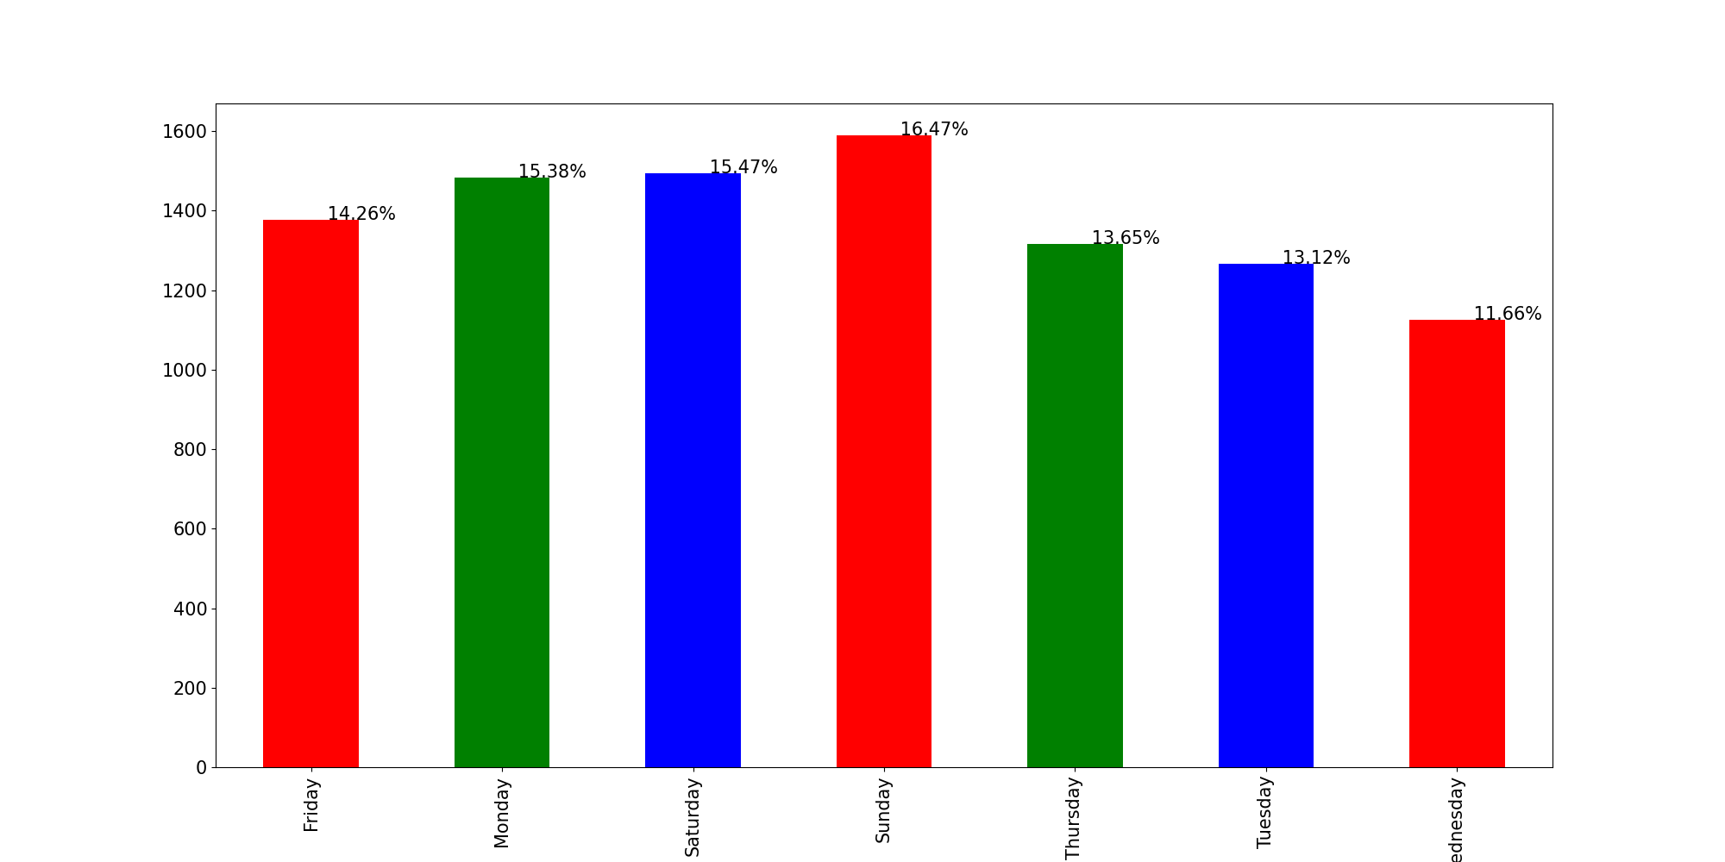
Day Wise Fraud
Week ends has relatively high numbers o Fraud transaction

Slide 15
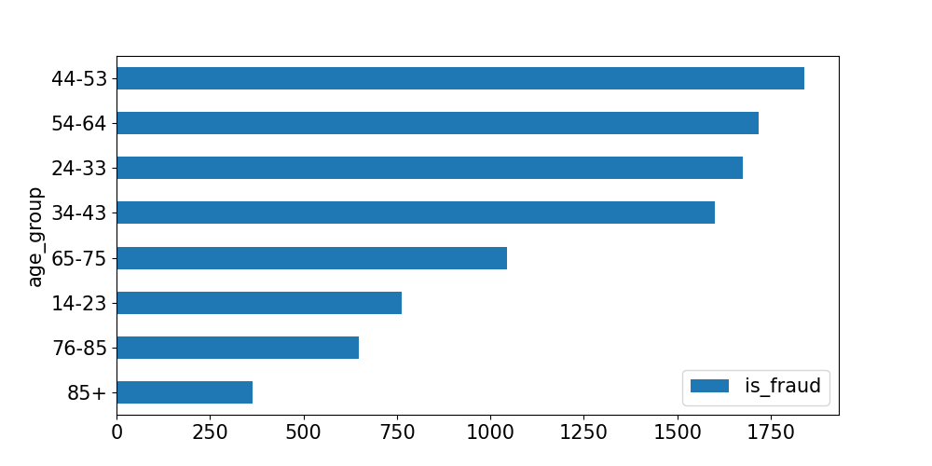
Age Vs Fraud Victims
Any age group – As per the ratio of age group in the data set almost all got victimized on an same average

Slide 16
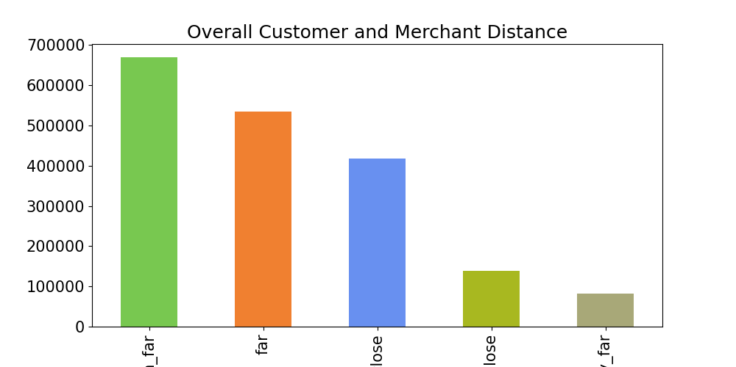
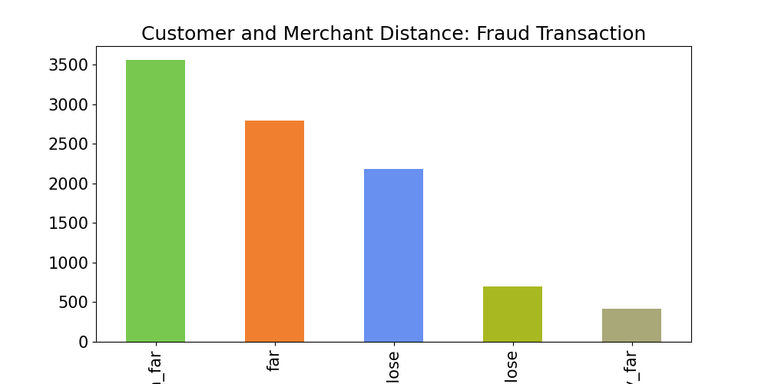
Fraud Don’t Care About Distance
Distance : Not a Biased Fraud Transaction

Slide 17
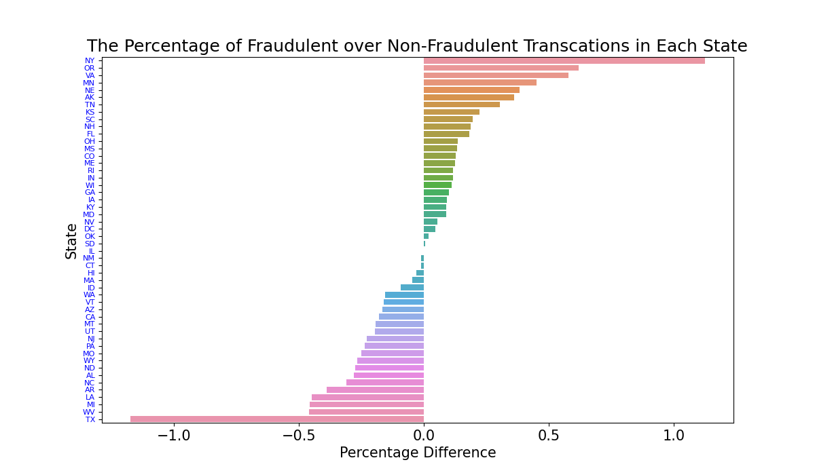
State Wise Fraud
NY and OH among others have a higher percentage of fraudulent transactions than normal ones, while TX and MT are the opposite. However, it should be pointed out that the percentage differences in those states are not very significant but a correlation does exist.

Slide 18
Last 24 hrs transaction is Crucial
It has been seen that last 24 hrs transaction is very much crucial to detect the fraud.
The Same is Derived as new Feature.
As Victim can’t report fraud within 2hrs, all transaction removed those done in last for fraud transaction 2 hrs time.
Last 24 hrs transaction has 77% positive correlation with Fraud Transaction

Slide 19
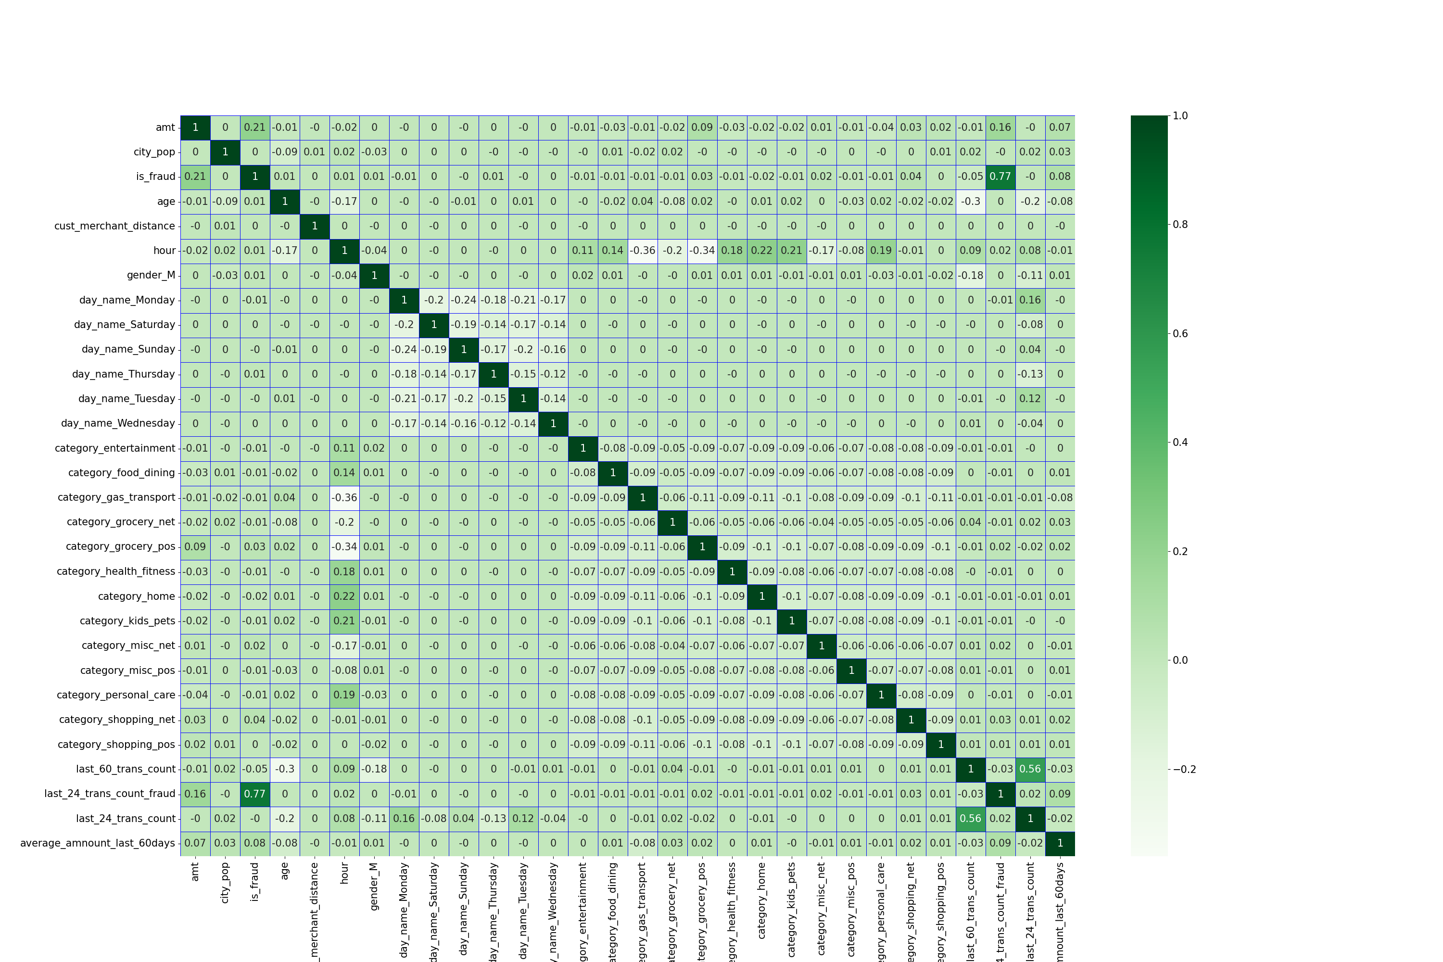
Last 24 hrs transaction is Crucial

Slide 20
ML-Importance-Use Case
Using ML we can detect the fraud on spot.
And Can inform Customers about fraud Transaction.
Immediate identification of fraud transaction can prevent the same.
Hence the Goal of retaining High value customers and smooth growth can be saved.
We Have used XGB 8 model to Detect the Fraud

Slide 21
ML saves 99.72% /Month
S. No | Particular | Numbers
1 | Cost incurred per month before the model was deployed | $2,13,462.00
2 | Average number of transactions per month detected as fraudulent by the model | 402
3 | Cost of providing customer executive support per fraudulent transaction detected by the model | $1.50
4 | Total cost of providing customer support per month for fraudulent transactions detected by the model | $603.00
5 | Average number of transactions per month that are fraudulent but not detected by the model | 0
6 | Cost incurred due to fraudulent transactions left undetected by the model | $0.00
7 | Cost incurred per month after the model is built and deployed | $603.00
8 | Final savings = Cost incurred before - Cost incurred after | $2,12,859.00
XGB 8 helps to Save : $2,12,859.00/Per Month
After Deploying the model

Slide 22
Recommendation
Bank Should Block All The Transaction Those Will Be Detected by the Model as Fraud.
Bank Should Inform Immediately Through all Medium (Over Call, Mail, Msg) The Customer, Regarding The Transaction which will be been pointed by the model as Fraud.

Slide 23
If You are Interested On Technical Part Welcome To The Same!
Technical Part

Slide 24
About The Data Provide
2 Data sets: “fraudTrain” , “fraudTest”
After Merging:
Rows = 1852394 , Columns = 23
Columns are:
'trans_date_trans_time‘ 'state’ 'is_fraud’
'cc_num', ‘zip’
'merchant', ‘lat’
'category', ‘long’
'amt', ‘city_pop’
'gender', ‘job’
'street', ‘dob’
'city', ‘trans_num’
'merch_lat', 'merch_long',

Slide 25
New Derived Features
'trans_date',
'last_60_trans_count',
'last_2_trans_count_fraud',
'last_24_trans_count_fraud',
'last_24_trans_count', ‘
average_amnount_last_60days‘
'age',
'cust_merchant_distance',
'hour',
'Year',
'Month', ‘
minutes',
'age_group',
'distance_flag',
'gender_M',
'day_name_Monday',
'day_name_Wednesday',
'category_entertainment',
'category_food_dining',
'category_gas_transport',
'category_grocery_net',
'category_grocery_pos',
'category_health_fitness',
'category_home',
'category_kids_pets',
'category_misc_net',
'category_misc_pos',
'category_personal_care',
'category_shopping_net',
'category_shopping_pos‘,
‘dis’
'day_name_Saturday',
'day_name_Sunday',
'day_name_Thursday',
'day_name_Tuesday',

Slide 26
Different Model Performance Analysis

Slide 27
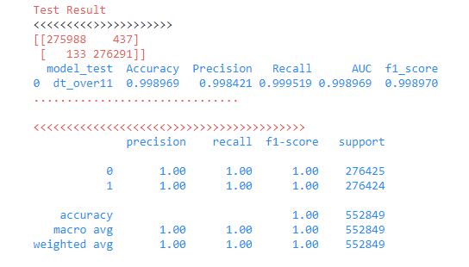
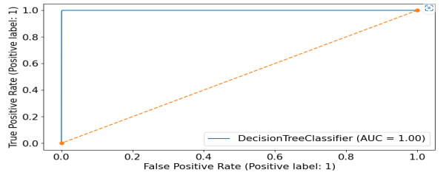
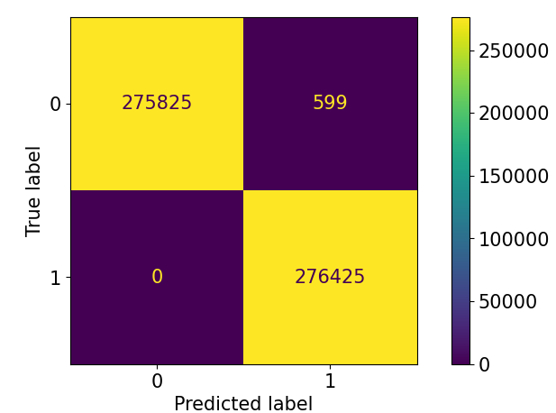
DT with 11 Features Performance With features
Performance
AUC
Missed Fraud = 0
This Model will not be taken as Here False Features are More Compare to Lighter Model

Slide 28
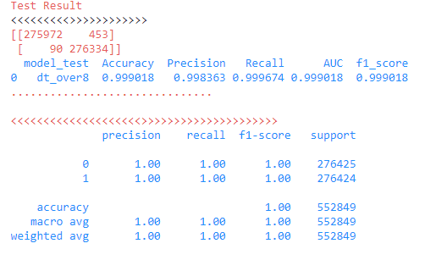
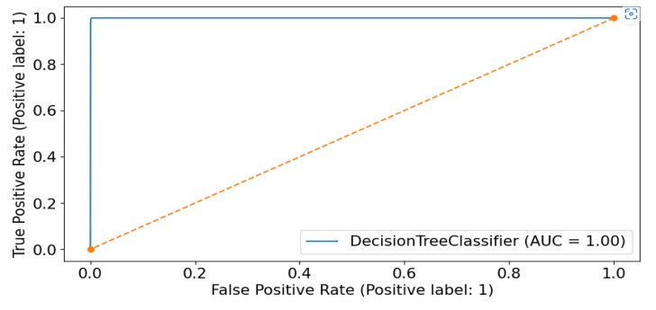
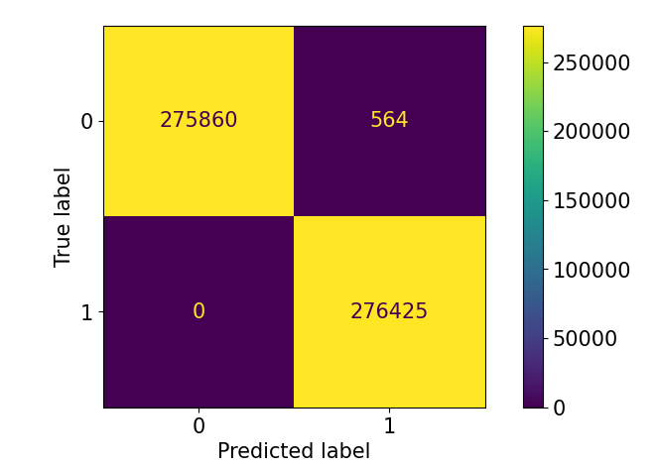
DT with 8 Features Performance With features
Performance
AUC
Missed Fraud = 0
This Model is Good Model we May Consider!

Slide 29
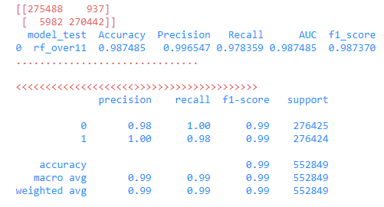

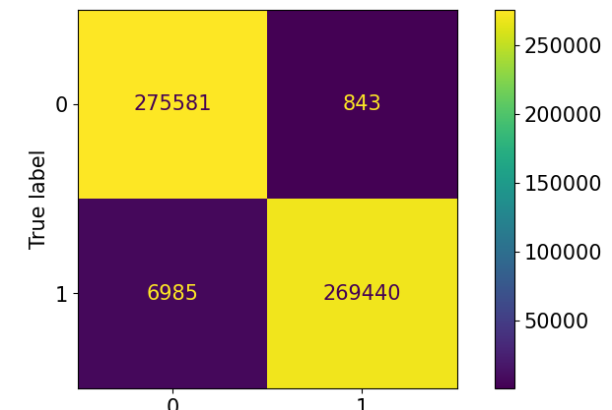
RF with 11 Features Performance With features
Performance
AUC
Missed Fraud = 5982
This Model will not be taken as Here False Negative is Higher Than any DT models

Slide 30
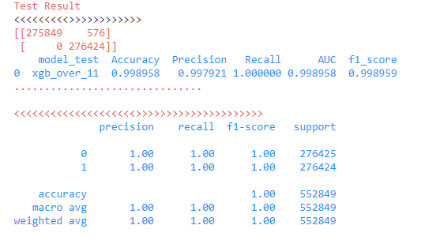

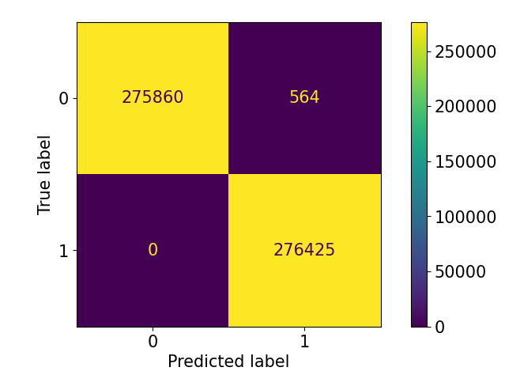
XGB with 11 Features Performance With features
Performance
AUC
Missed Fraud = 0
This Model Has Worked the Best with 0 False Negative

Slide 31

XGB with 8 Features Performance With features
Performance
AUC
Missed Fraud = 0
This Model Has Worked the Best with 0 False Negative and has less Features

Slide 32
Recall- To catch the Fraud
Recall= TP/(TP+FN)
TP = True Positive
FN = False Negative
In Fraud Detection False Negative should be less.
# In 24 months data all fraud transaction are Detected by the Model xgb with 8 features .
# Per Month Misses = 0
We have taken here Recall to Get the main performance of Models
Test missed = 0
Train missed = 0

Slide 33
Final Model Selection
Model Name | Accuracy | Precision | Recall | AUC | F1_score
xgb_over_8 | 99.90 | 99.80 | 100.00 | 100.00 | 99.90
xgb_over_11 | 99.90 | 99.80 | 100.00 | 100.00 | 99.90
dt_over8 | 99.90 | 99.80 | 99.97 | 100.00 | 99.90
dt_over11 | 99.90 | 99.80 | 99.95 | 100.00 | 99.90
rf_over11 | 98.80 | 99.70 | 97.80 | 99.00 | 98.70
We Have Further Taken XGB 8: Final Model

Slide 34
Thank You

